Slide 1
Reliability and Validity of smartphone-based cognitive-motivational experiments in alcohol use order
Figures

Slide 2
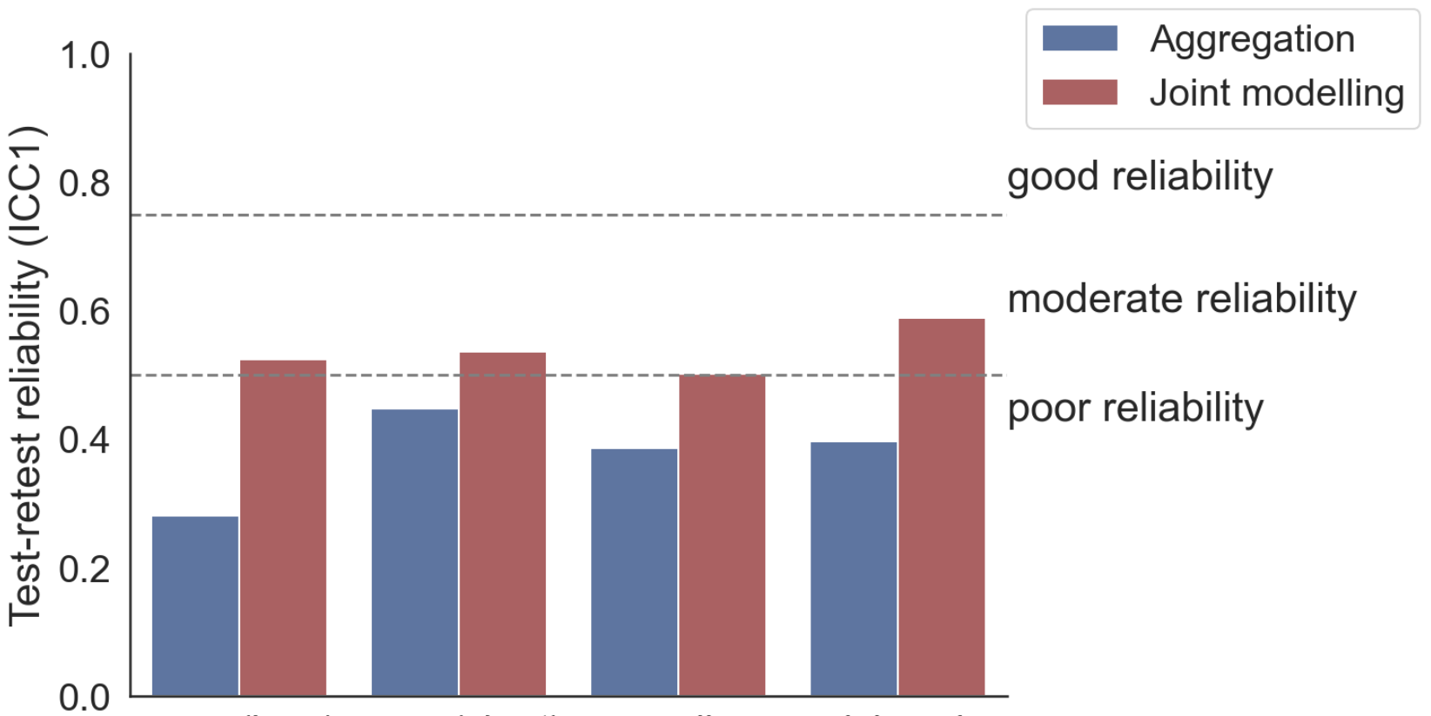
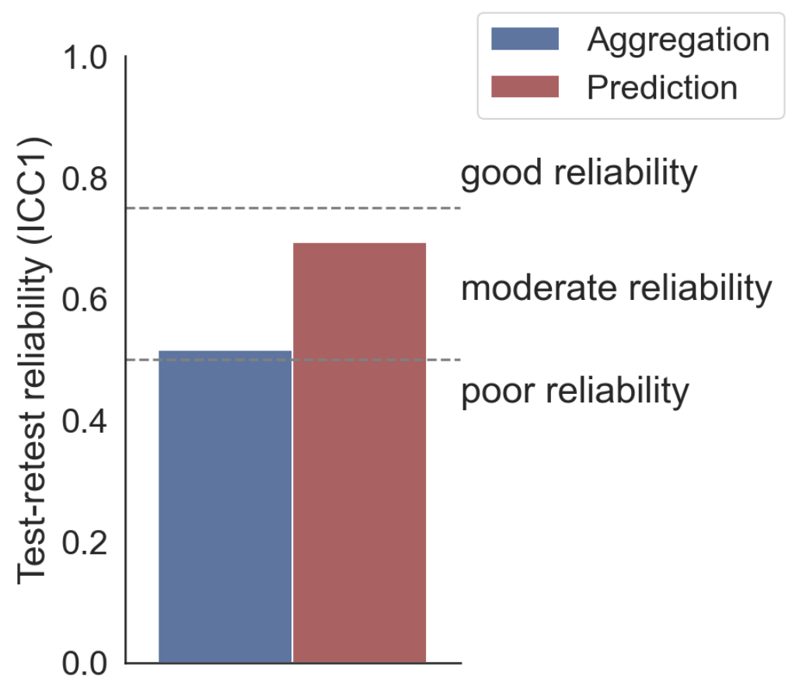
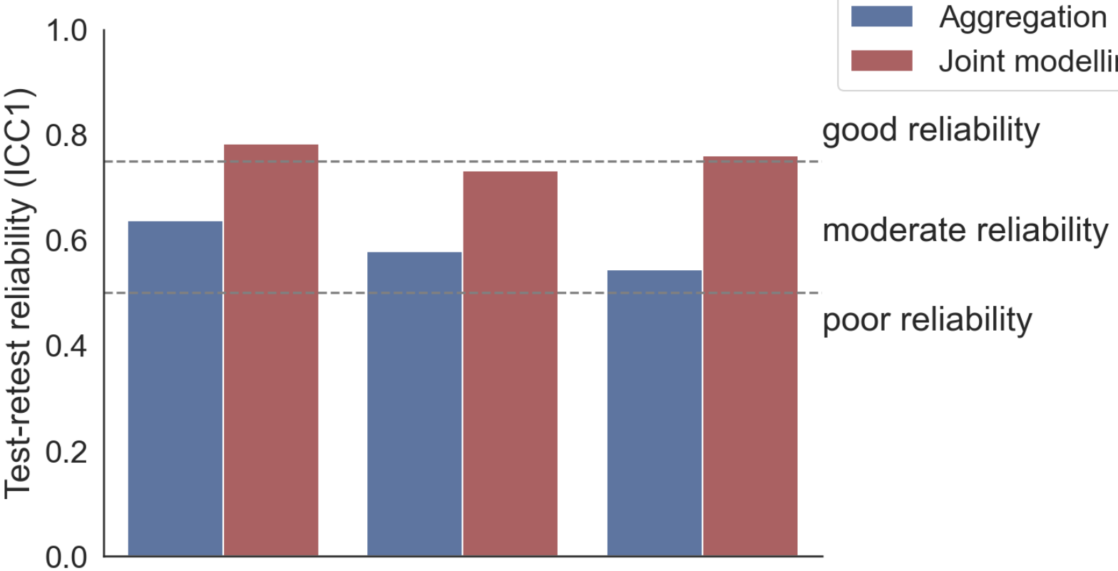
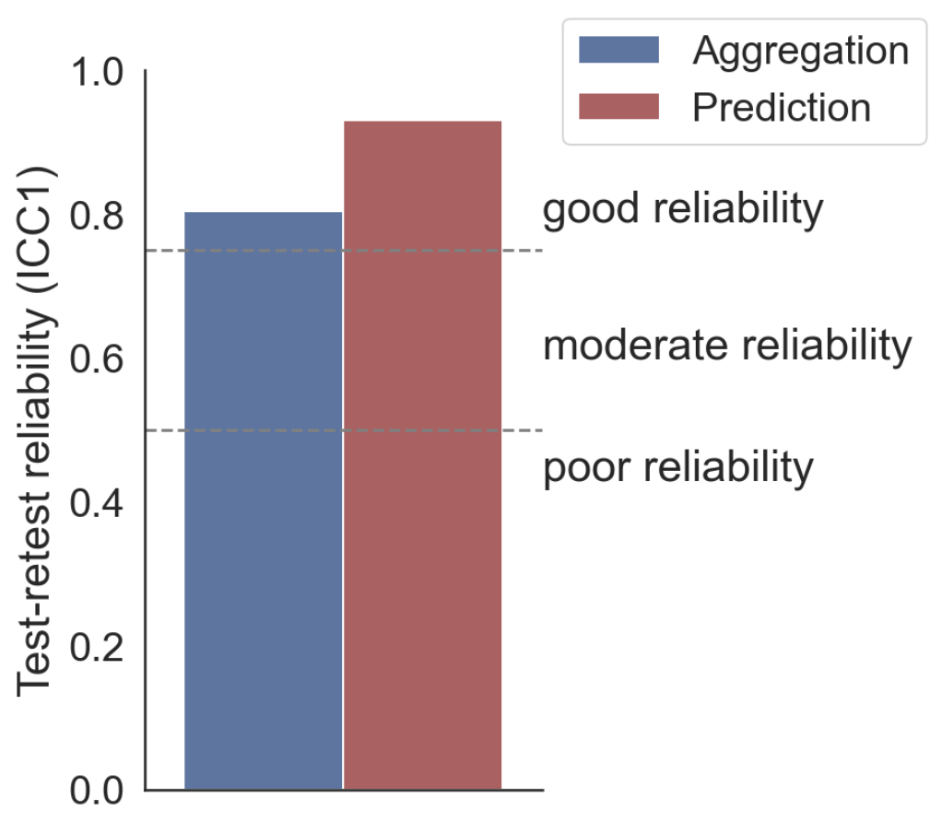
A: Working memory task
B: Stop signal task
no (long)
no (short)
encoding
delayed
SSRT
C: Risk taking task
D: Information sampling task
win
loss
mixed
oversampling

Slide 3
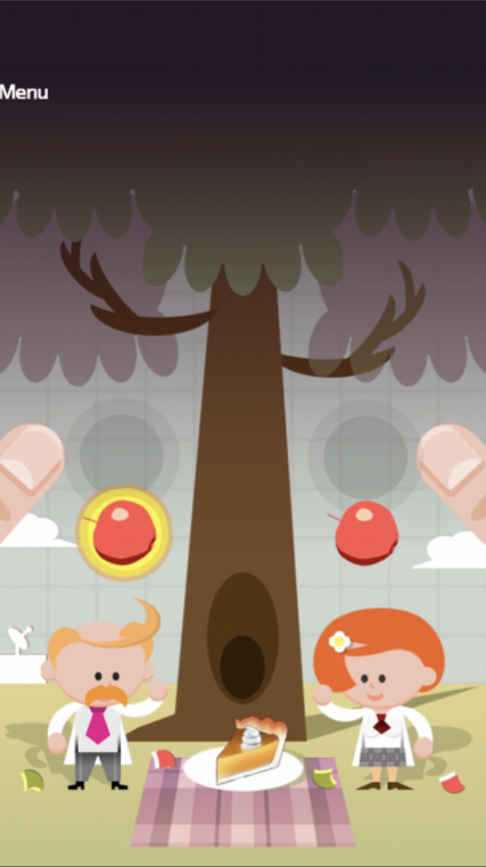
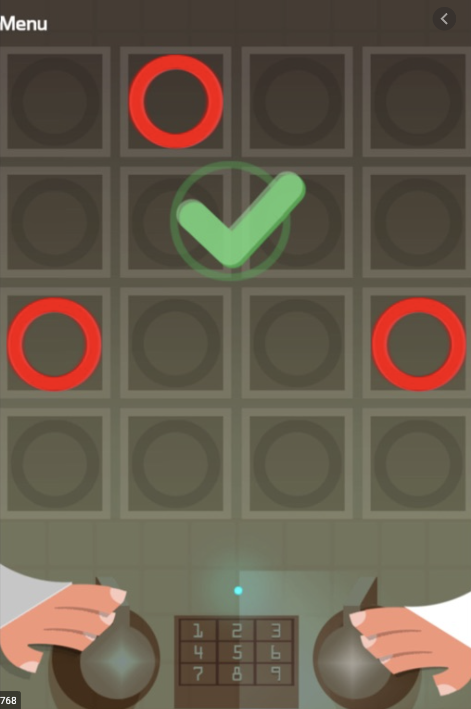
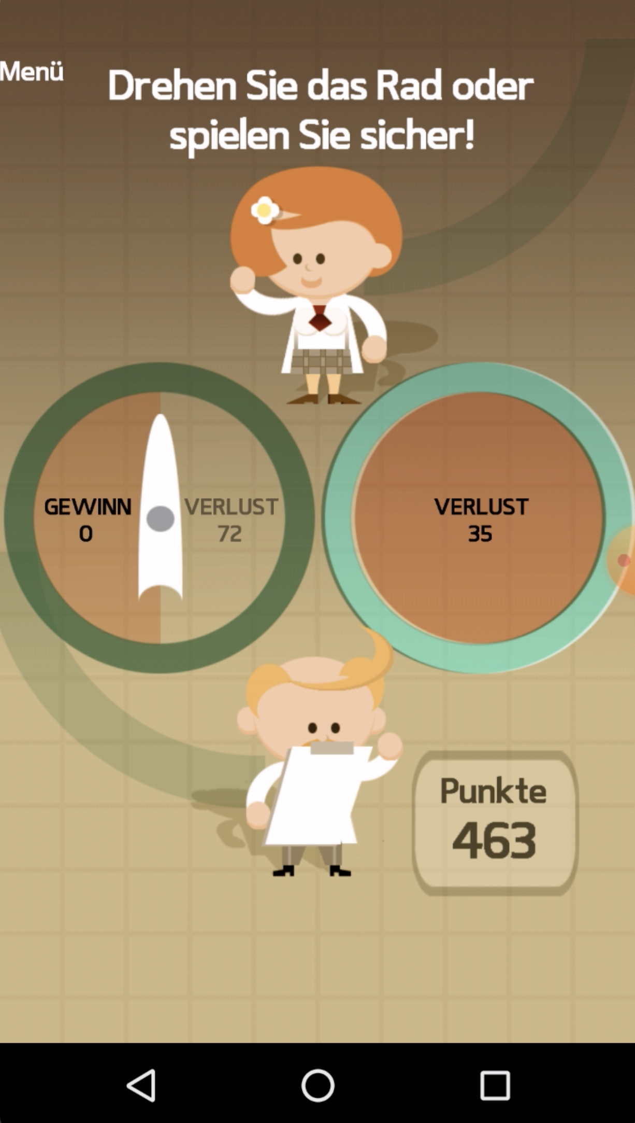
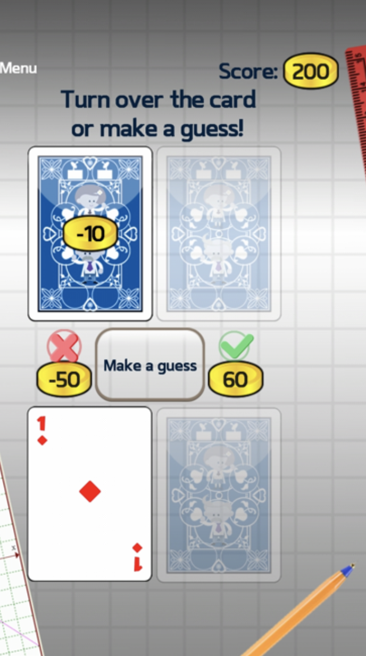
A: Response inhibition
B: Working memory
C: Risk taking
D: Information sampling

Slide 4
A: Response inhibition
B: Working memory
C: Risk taking
D: Information sampling
2 Baseline measurements
Day 1
Day 365
Retrospective drinking questions
App installation

Slide 5
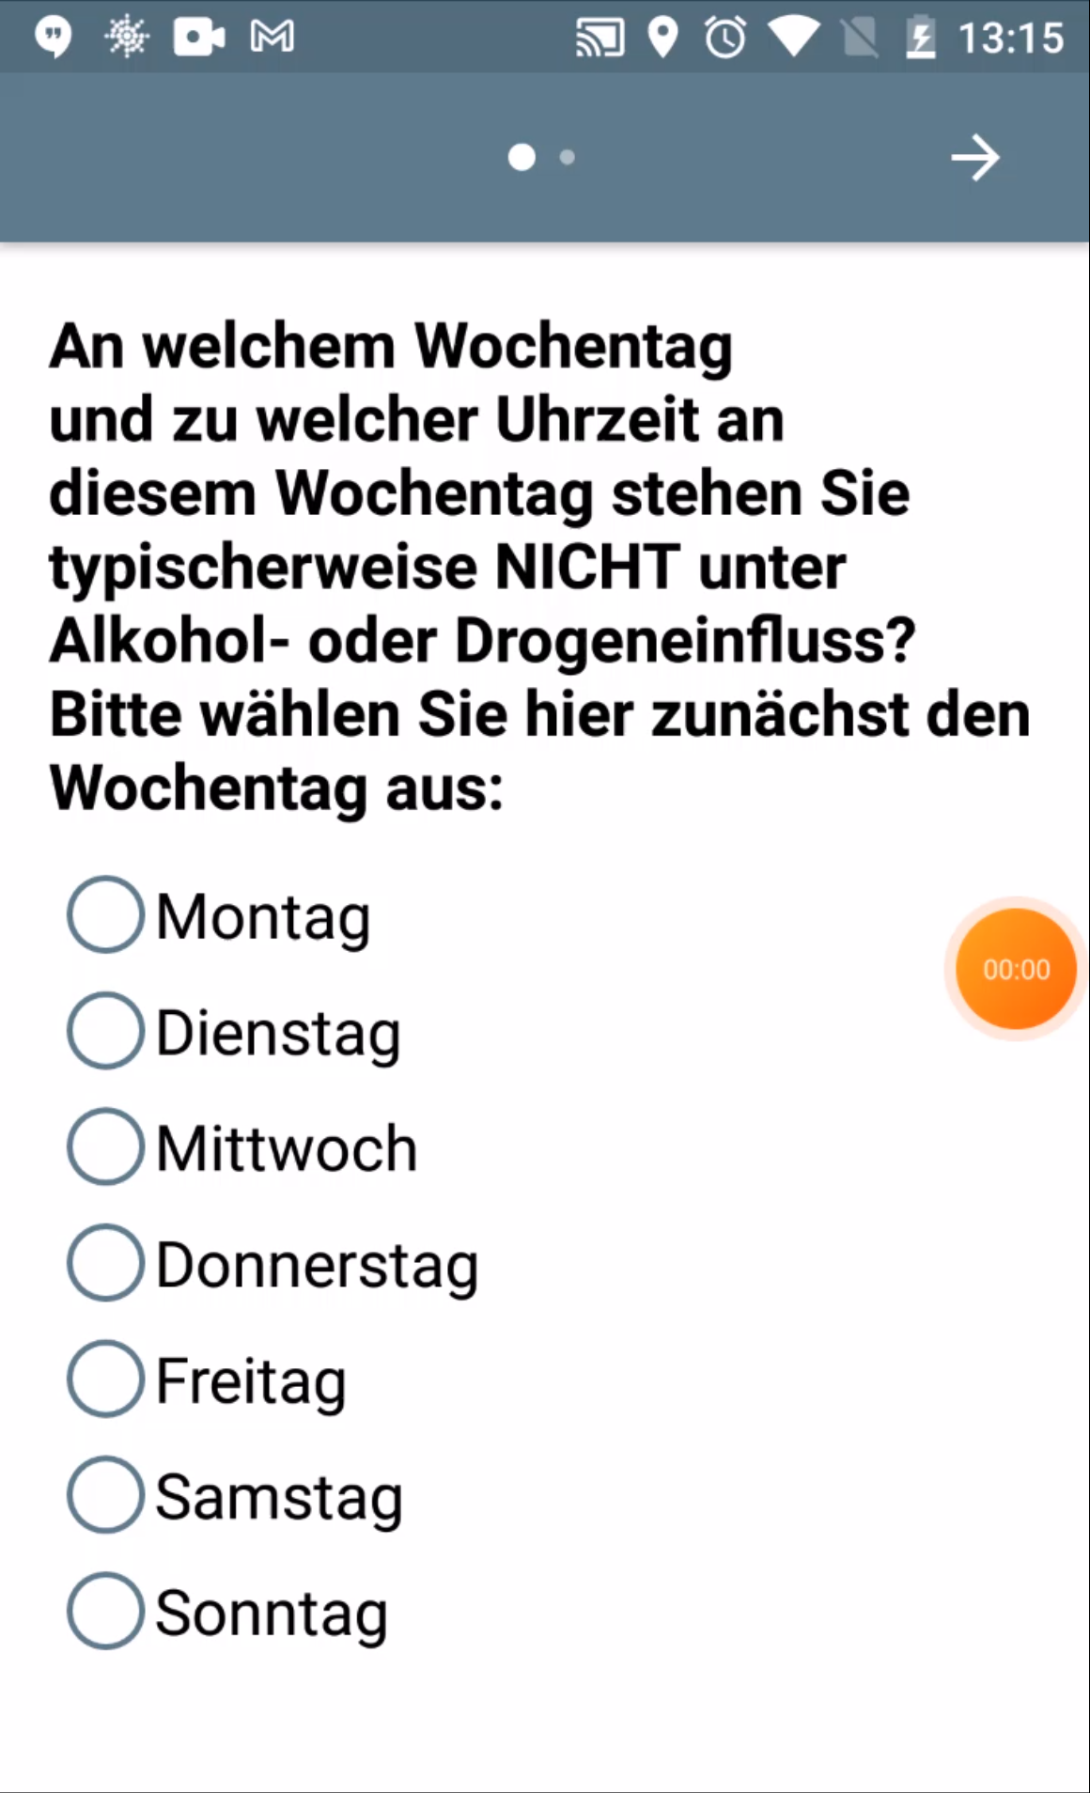
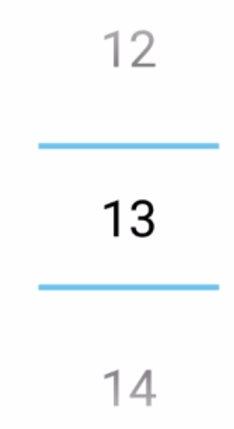
A: Stop signal
B: Working memory
C: Risk taking
D: Information sampling
D: Information sampling
Think about yesterday. Which and how many drinks did you consume?
Small beers (0.2L)
Medium beers (0.33L)
…
…
Day 1
first Monday
every 2 days
4-weekly
Day 365
Retrospective drinking questions
Two baseline GBEs
EMA drinking questions
One EMA GBE

Slide 6
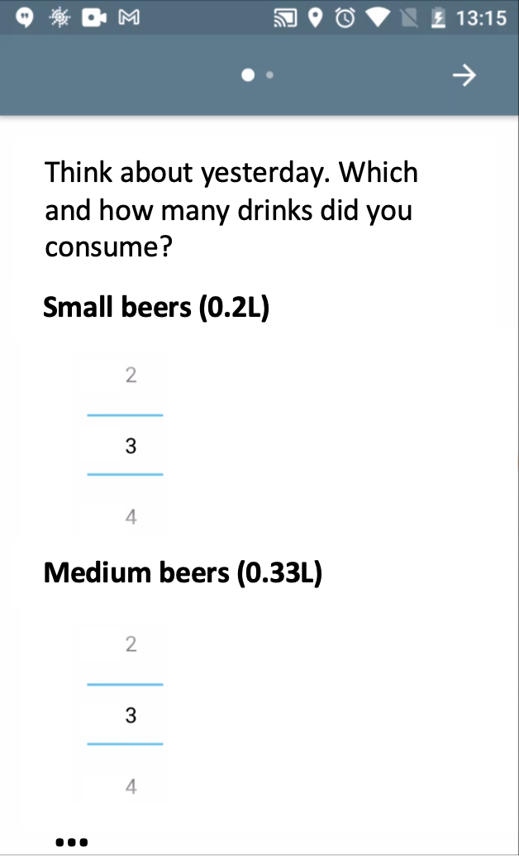
A: Stop signal
B: Working memory
C: Risk taking
D: Information sampling
E: EMA Drinking questions
F: Timeline
…
Day 1
first Monday
every 2 days
every 4 weeks
1 Year
Retrospective drinking questions
Two baseline GBEs
EMA drinking questions
One EMA GBE

Slide 7
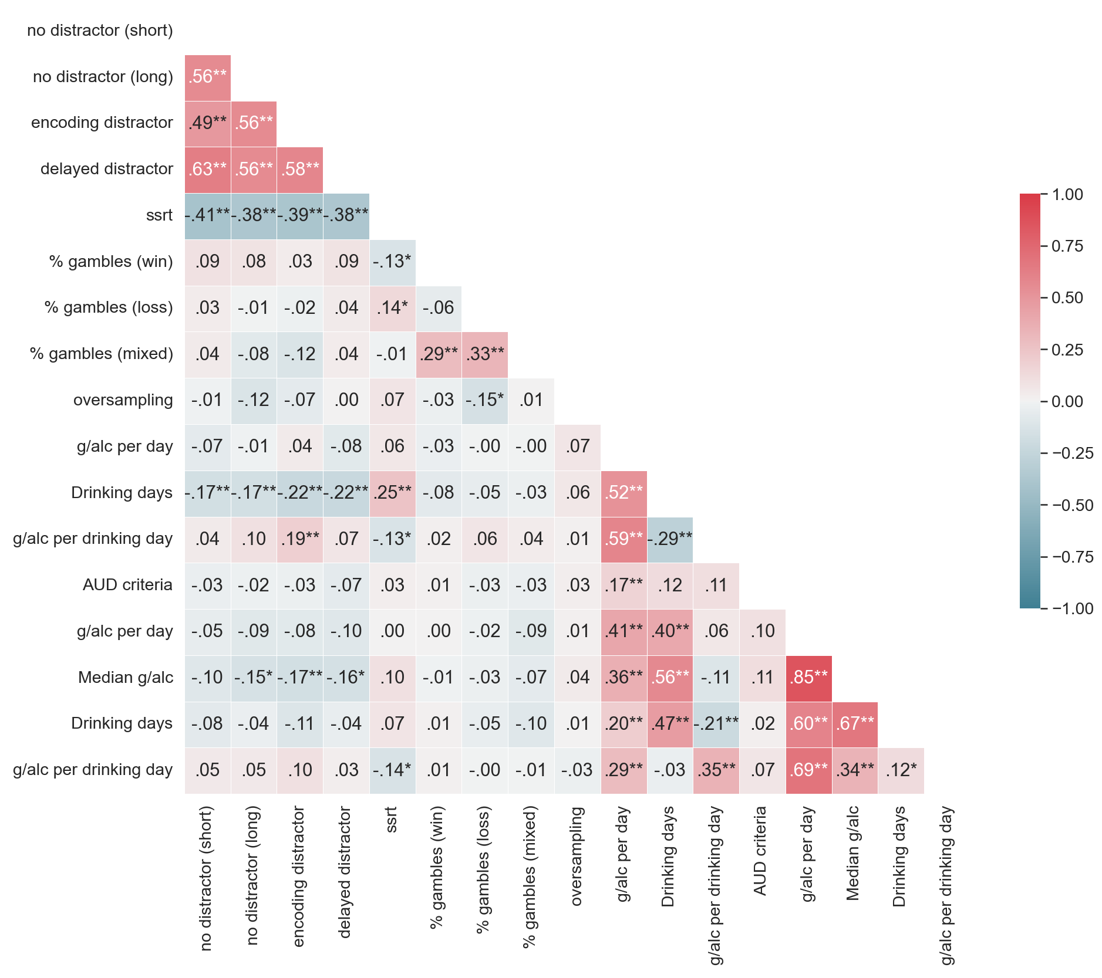
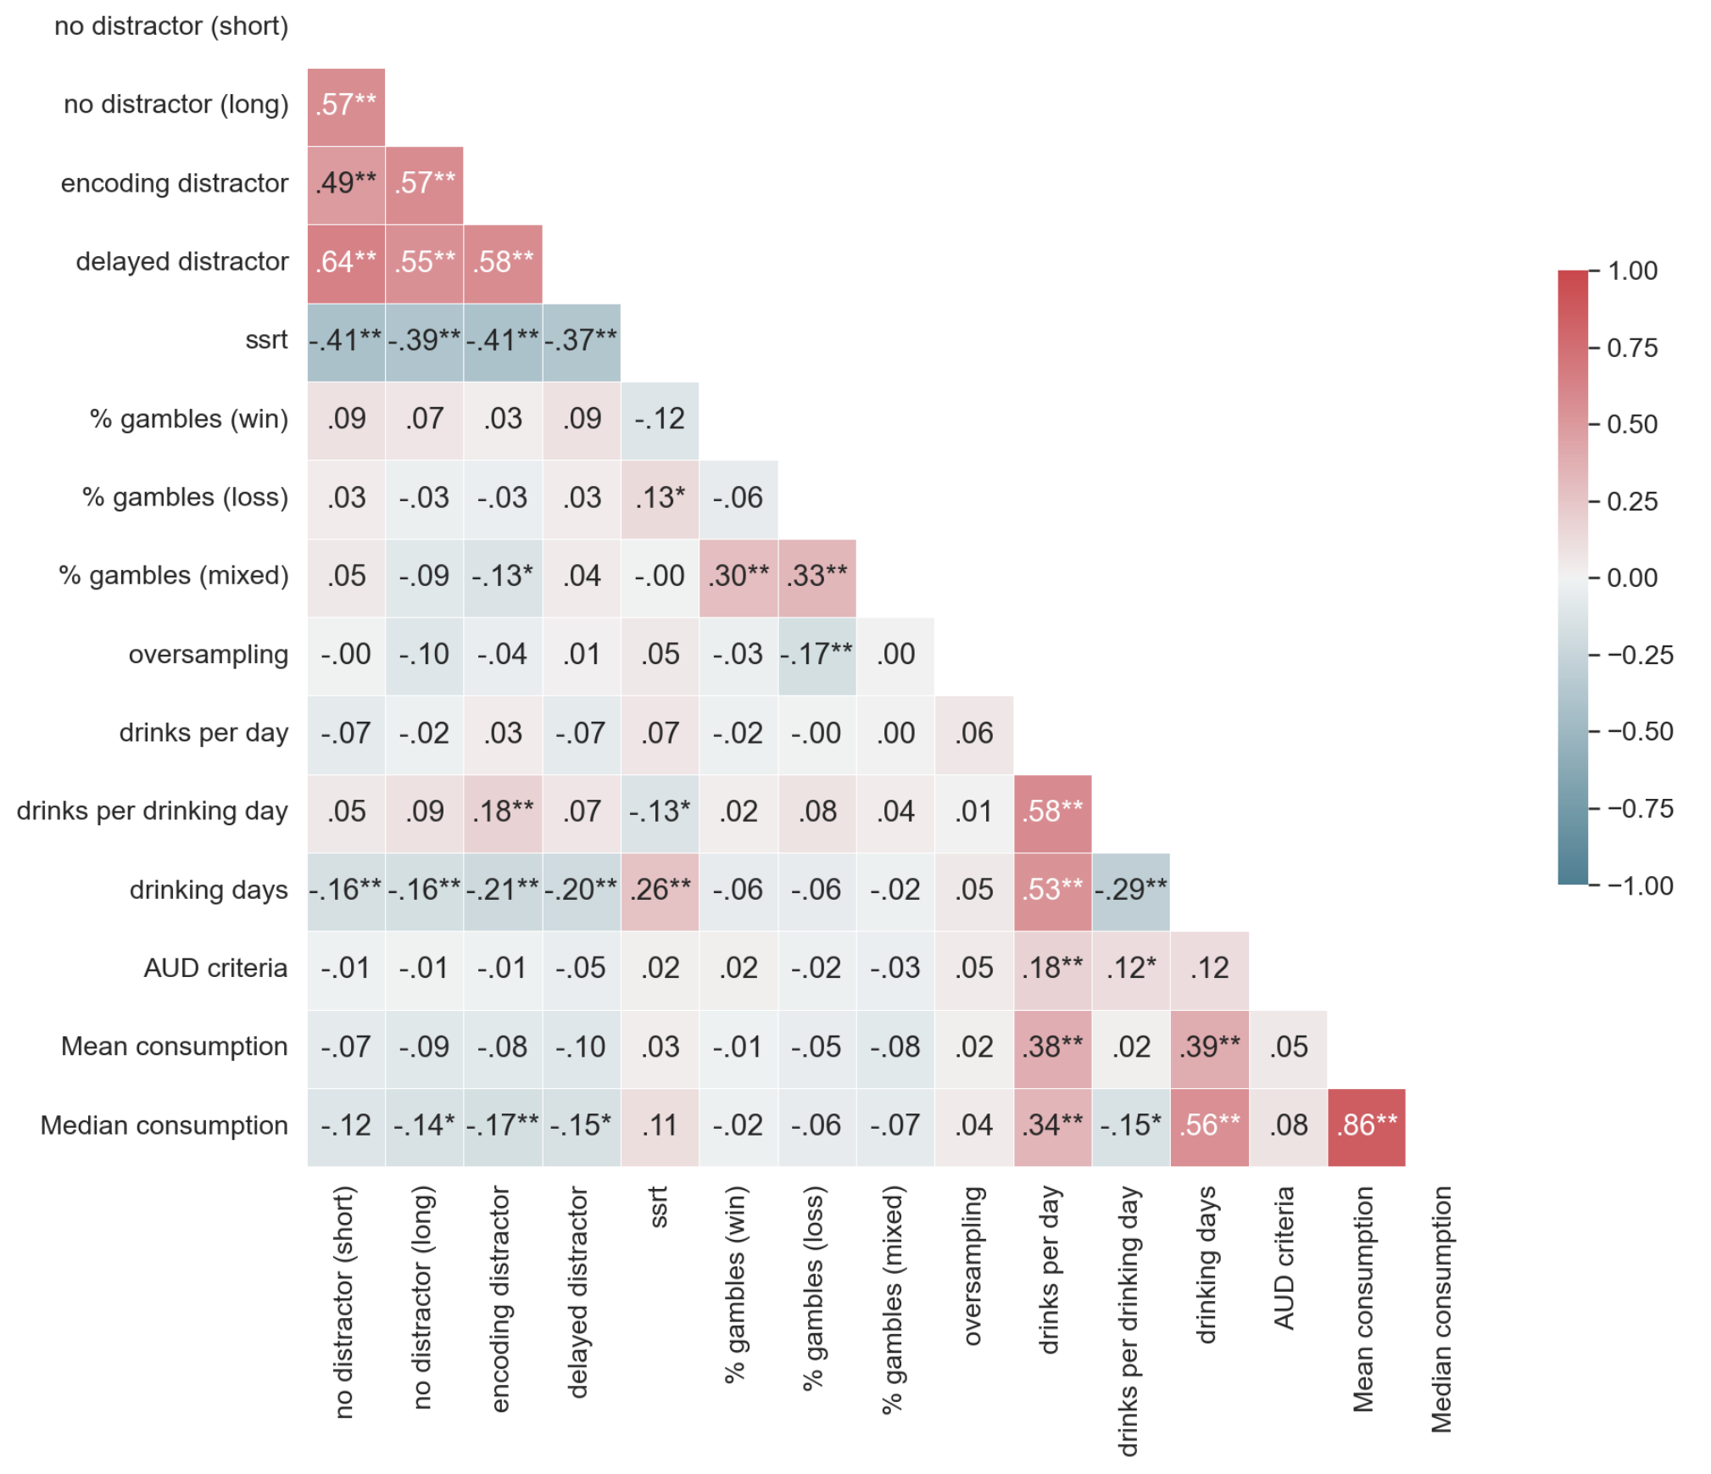
Working
memory
Inhibition
Risk taking
Information
sampling
Retrospective
drinking
AUD criteria
EMA drinking
Notes:
This is the definitive version

Slide 8
Working
memory
Inhibition
Risk taking
Information
sampling
Retrospective
drinking
AUD criteria
EMA drinking

Slide 9
Working memory
Working
memory
Inhibition
Risk taking
Inhibition
Risk taking
Information
sampling
Retrospective
drinking
AUD criteria
EMA drinking

Slide 10
No distractor (short)
Working
memory
No distractor (long)
Encoding distractor
Delayed distractor
Inhibition
SSRT
% gambles (win)
Risk taking
% gambles (loss)
% gambles (mixed)
Information
sampling
Oversampling
Drinks per day
Retrospective
drinking
Drinks per drinking day
Drinking days
AUD criteria
AUD criteria
mean alcohol
consumption
EMA drinking
median alcohol
consumption

Slide 11
No distractor (short)
Working
memory
No distractor (long)
Encoding distractor
Delayed distractor
Inhibition
SSRT
% gambles (win)
Risk taking
% gambles (loss)
% gambles (mixed)
Information
sampling
Oversampling
Drinks per day
Retrospective
drinking
Drinks per drinking day
Drinking days
AUD criteria
AUD criteria
mean alcohol
consumption
EMA drinking
median alcohol
consumption

Slide 12
No distractor (short)
Working
memory
No distractor (long)
Encoding distractor
Delayed distractor
Inhibition
SSRT
% gambles (win)
Risk taking
% gambles (loss)
% gambles (mixed)
Information
sampling
Oversampling
Drinks per day
Retrospective
drinking
Drinks per drinking day
Drinking days
AUD criteria
AUD criteria
mean alcohol
consumption
EMA drinking
median alcohol
consumption

Slide 13
No distractor (short)
Working
memory
No distractor (long)
Encoding distractor
Delayed distractor
Inhibition
SSRT
% gambles (win)
Risk taking
% gambles (loss)
% gambles (mixed)
Information
sampling
Oversampling
Drinks per day
Retrospective
drinking
Drinks per drinking day
Drinking days
AUD criteria
AUD criteria
mean alcohol
consumption
EMA drinking
median alcohol
consumption

Slide 14
Working
memory
No distractor (long)
Encoding distractor
Delayed distractor
Inhibition
SSRT
% gambles (win)
Risk taking
% gambles (loss)
% gambles (mixed)
Information
sampling
Oversampling
Drinks per day
Retrospective
drinking
Drinks per drinking day
Drinking days
AUD criteria
AUD criteria
mean alcohol
consumption
EMA drinking
median alcohol
consumption

Slide 15
No distractor (short)
No distractor (long)
Working
memory
Encoding distractor
Delayed distractor
SSRT
Inhibition
% gambles (win)
% gambles (loss)
Risk taking
% gambles (mixed)
Oversampling
Information
sampling
Drinks per day
Drinks per drinking day
Retrospective
drinking
Drinking days
AUD criteria
AUD criteria
mean alcohol
consumption
EMA drinking
median alcohol
consumption

Slide 16
No distractor (short)
No distractor (long)
Encoding distractor
Working
memory
Delayed distractor
SSRT
% gambles (win)
Inhibition
% gambles (loss)
% gambles (mixed)
Risk taking
Oversampling
Drinks per day
Information
sampling
Drinks per drinking day
Drinking days
Retrospective
drinking
AUD criteria
mean alcohol
consumption
AUD criteria
median alcohol
consumption
EMA drinking

Slide 17
Working memory
Inhibition
Risk taking
Information sampling
Retrospective drinking
AUD criteria
EMA drinking

Slide 18
Working memory
Inhibition
Risk taking
Information sampling
Retrospective drinking
AUD criteria
EMA drinking

Slide 19
Working memory
Inhibition
Risk taking
Information sampling
Retrospective drinking
AUD criteria
EMA drinking

Slide 20
Working memory
Inhibition
Risk taking
Information sampling
Retrospective drinking
AUD criteria
EMA drinking

Slide 21
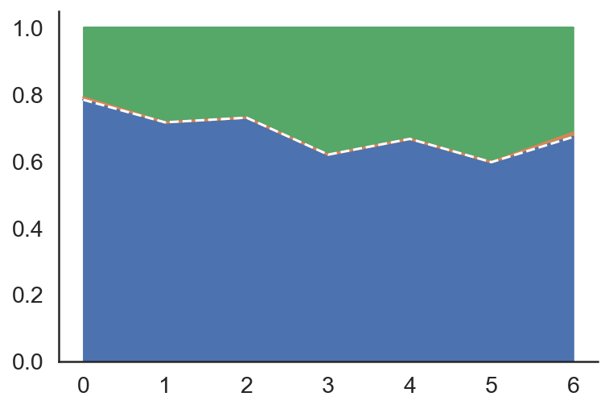
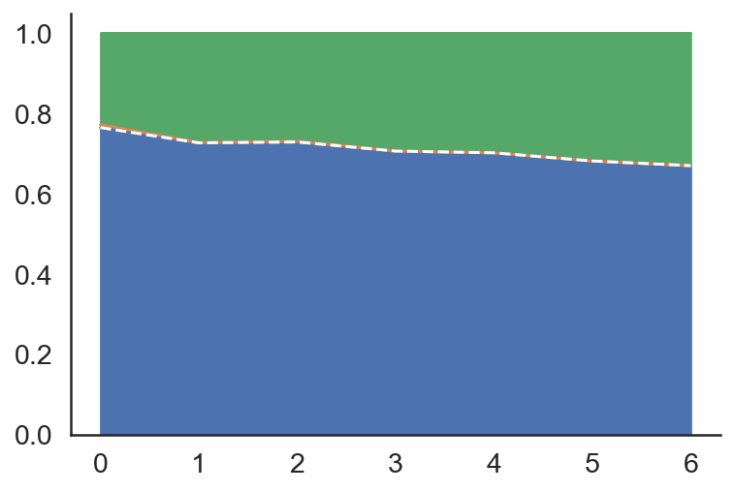
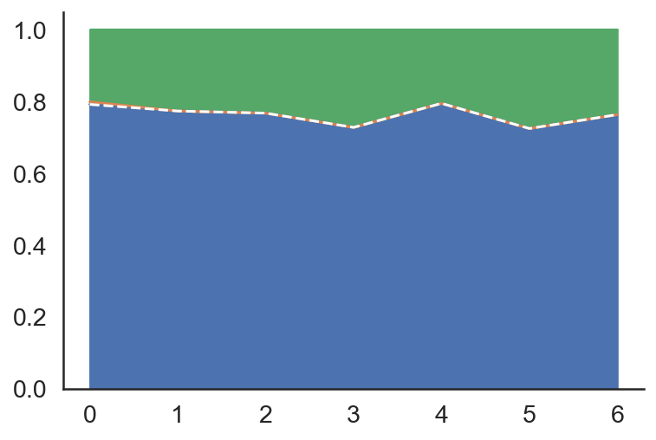
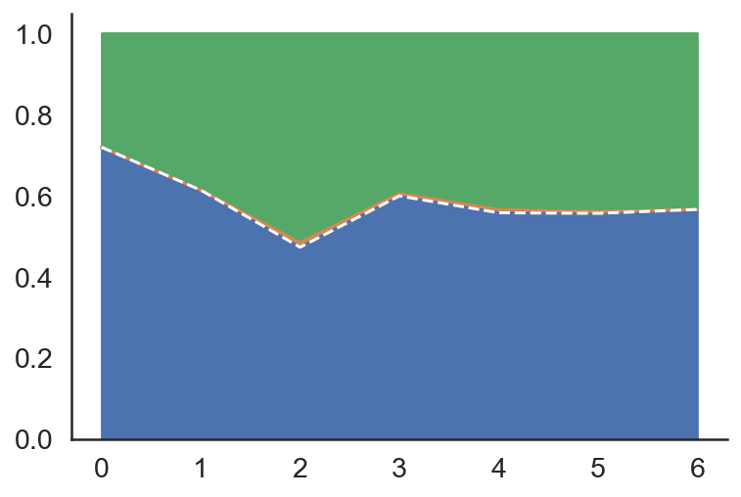
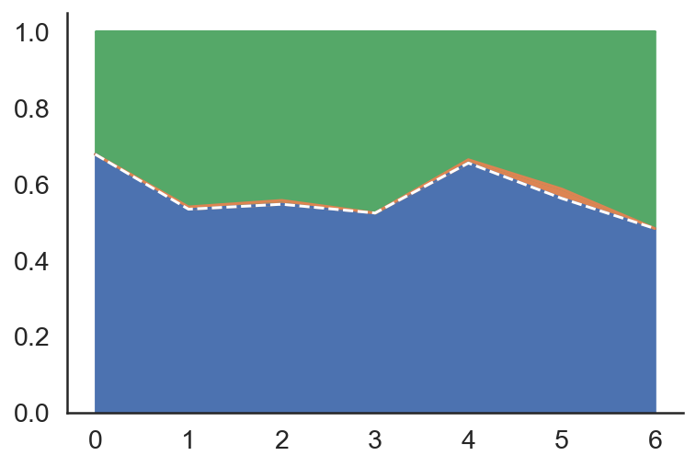
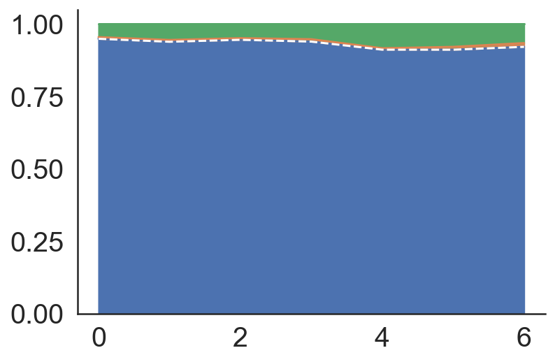
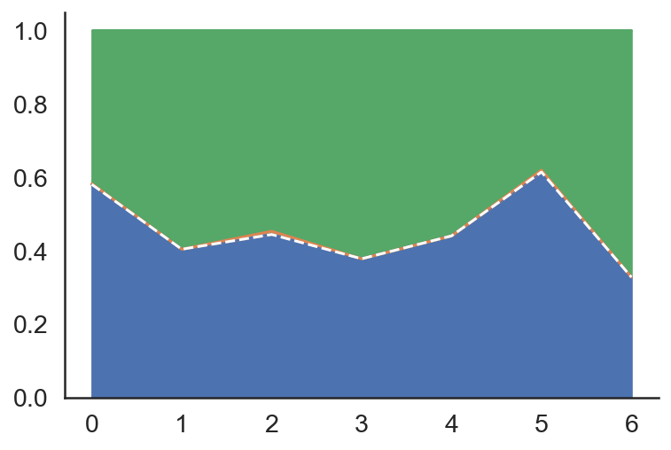
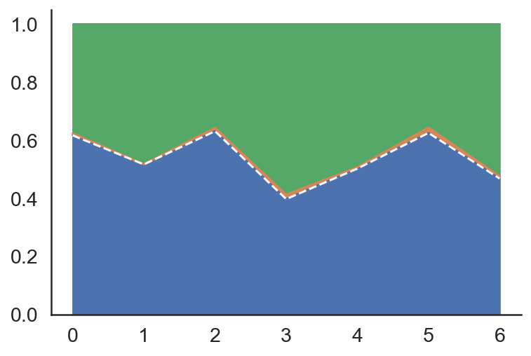
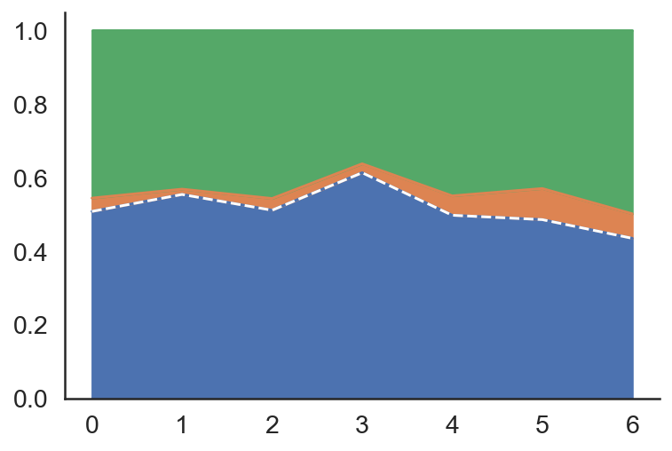
A: Risk Taking
% gambles (win)
% gambles (loss)
% gambles (mixed)
Variance
Residual
Proportion variance
Session
Participant
ICC
B: Working memory
C: Information sampling
No distractor (long)
No distractor (short)
Proportion variance
Encoding distractor
Delayed distractor
D: Response inhibition
Proportion variance
Months since first session
Months since first session
Months since first session

Slide 22
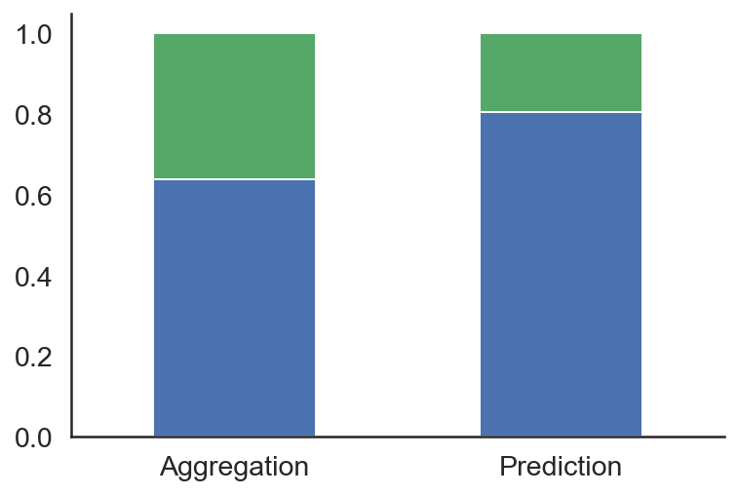
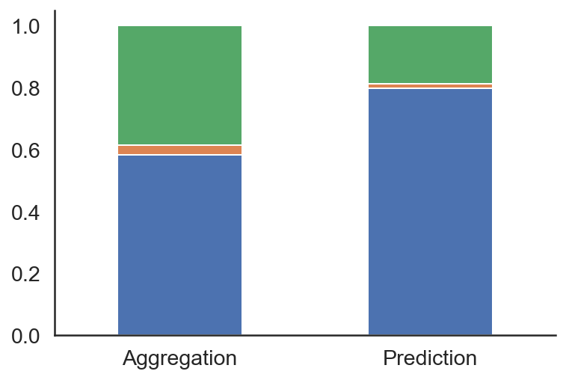
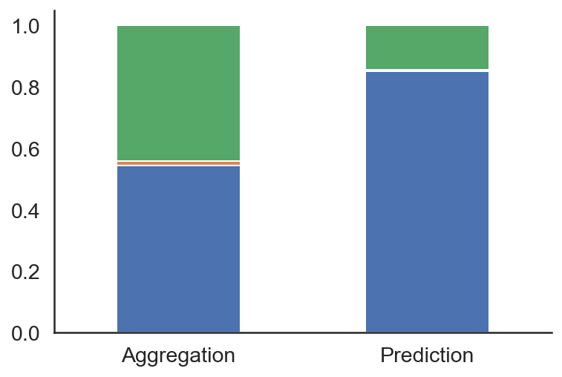
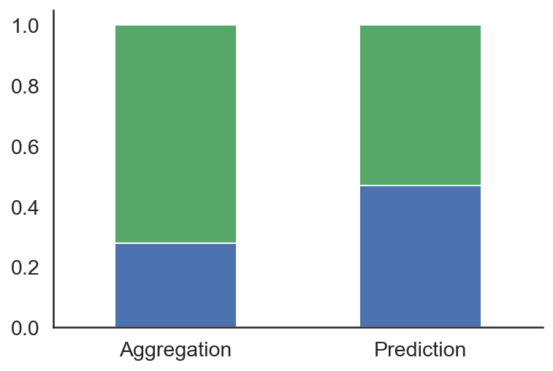
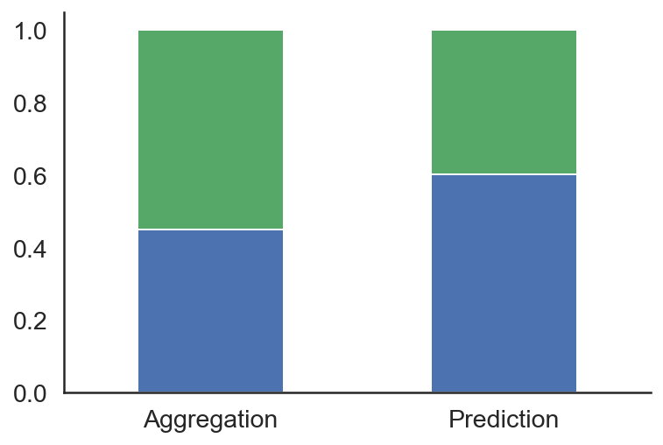
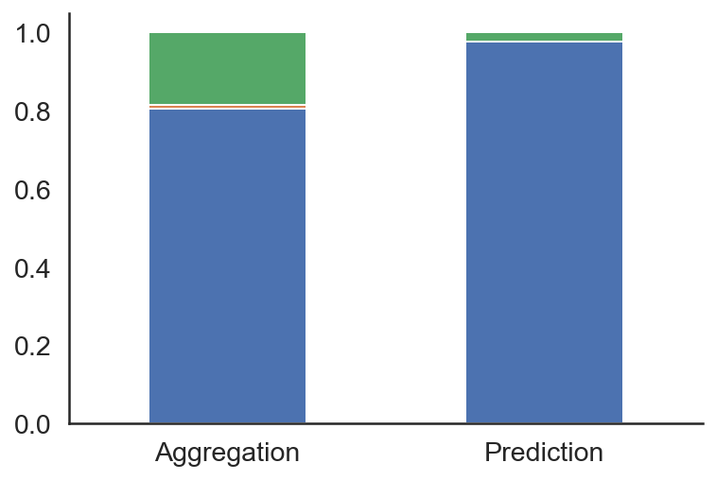
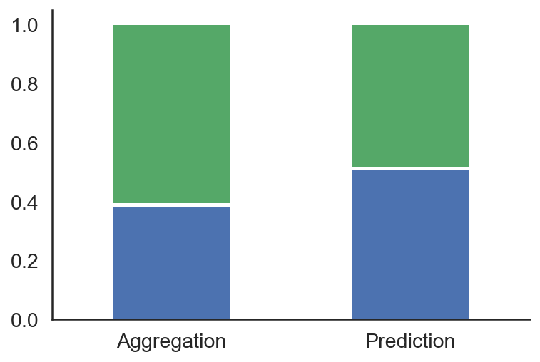
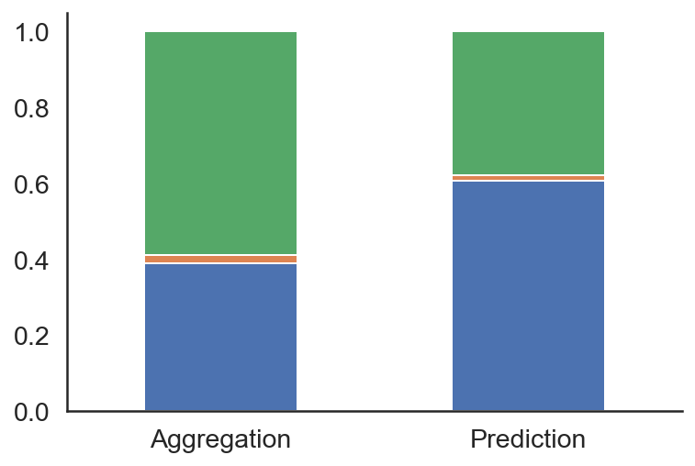
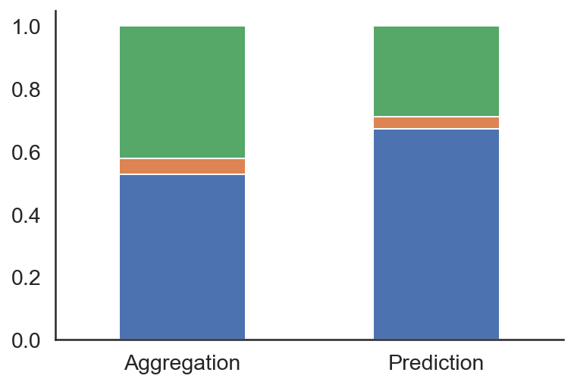
A: Risk Taking
% gambles (win)
% gambles (loss)
% gambles (mixed)
Variance
Residual
ICC
Session
Participant
B: Working memory
C: Information sampling
No distractor (long)
No distractor (short)
ICC
Encoding distractor
Delayed distractor
D: Stop signal
ICC

Slide 23
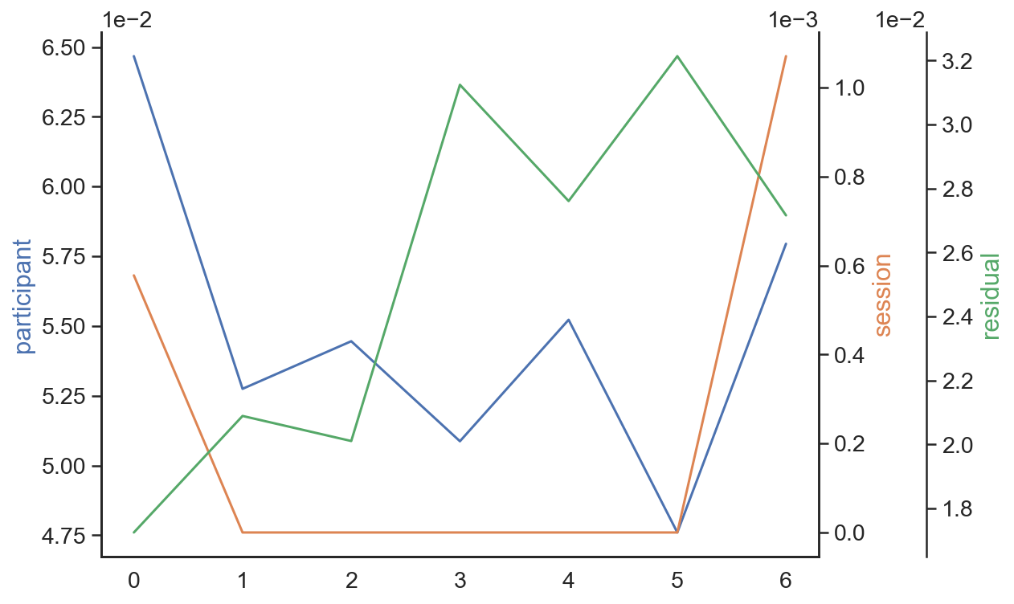
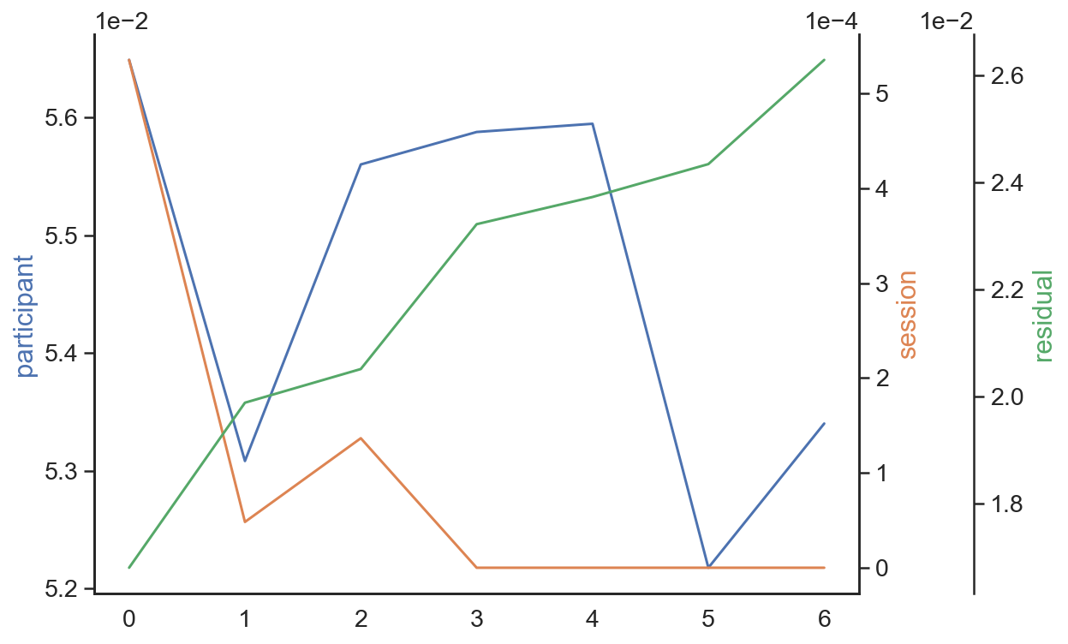
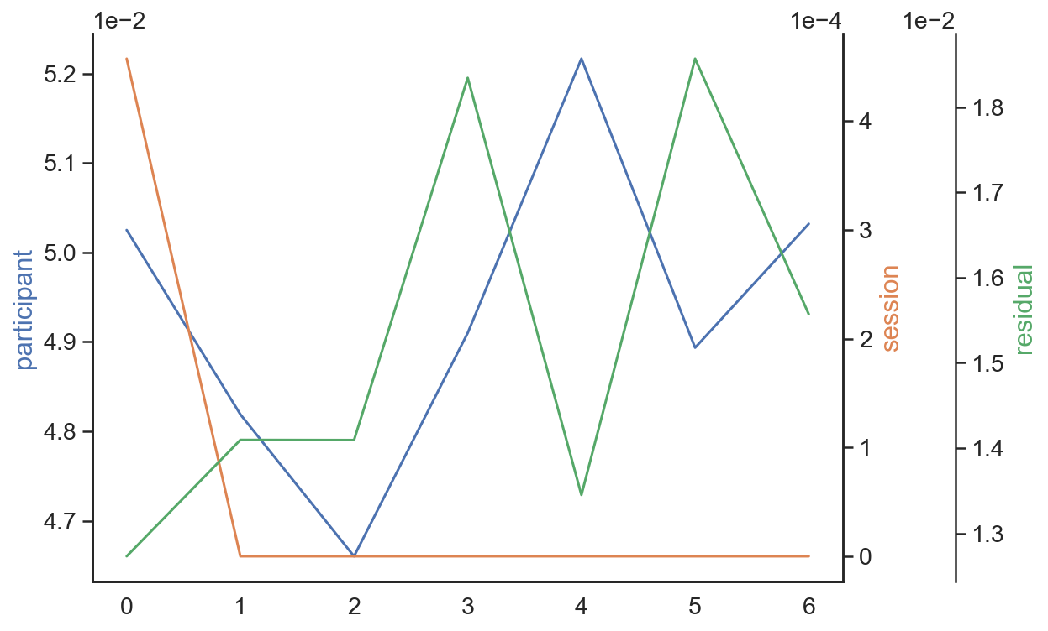
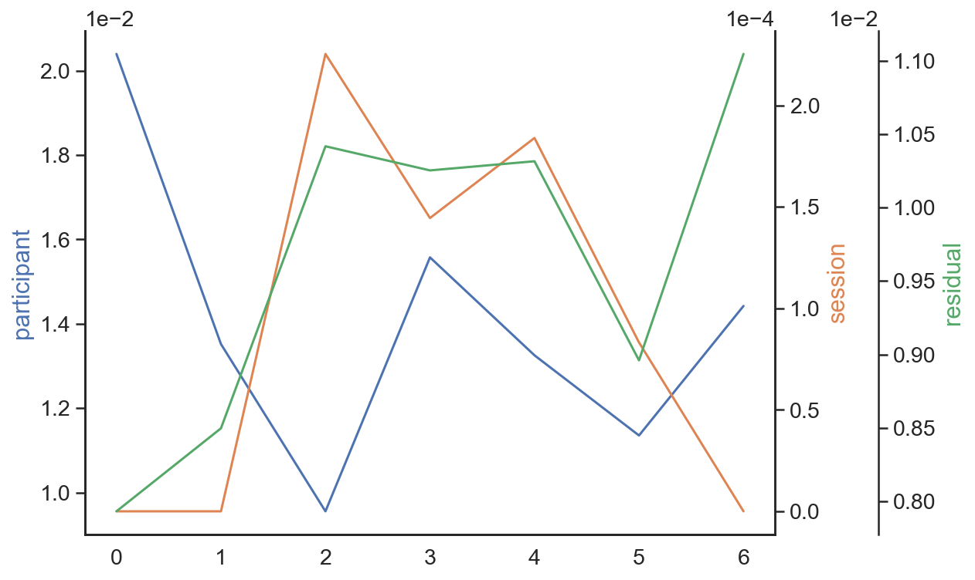
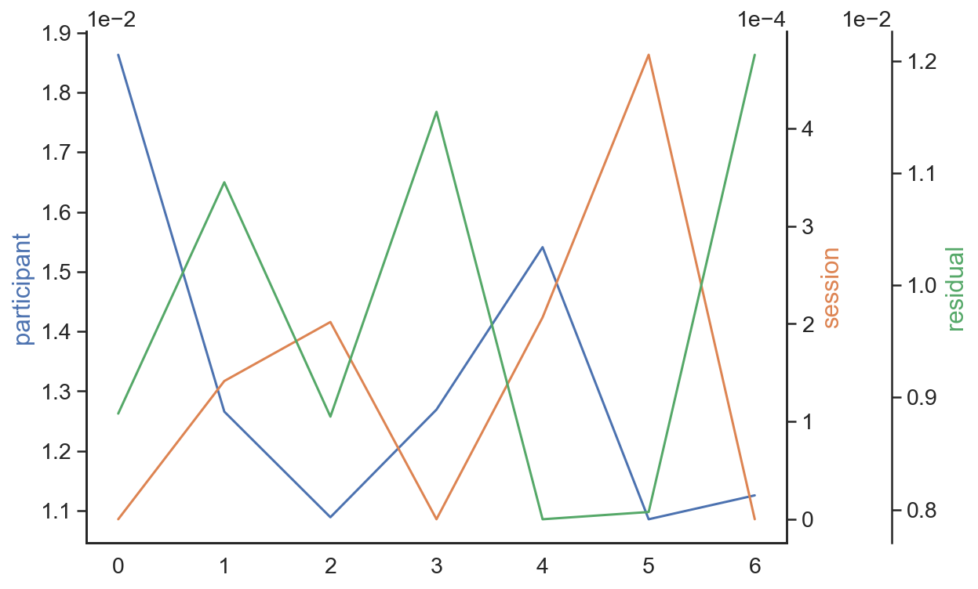
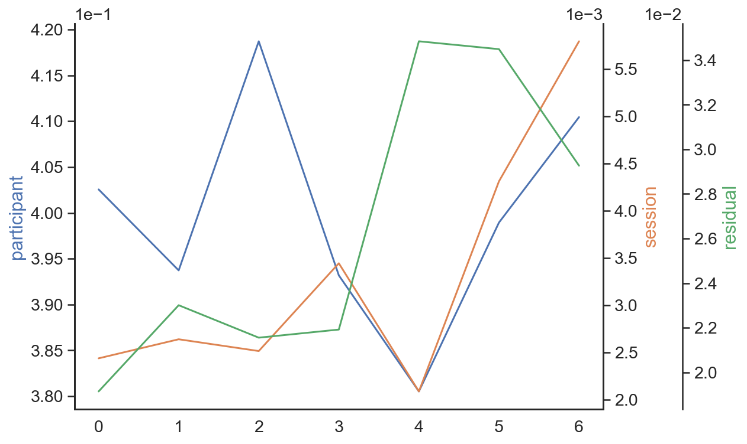
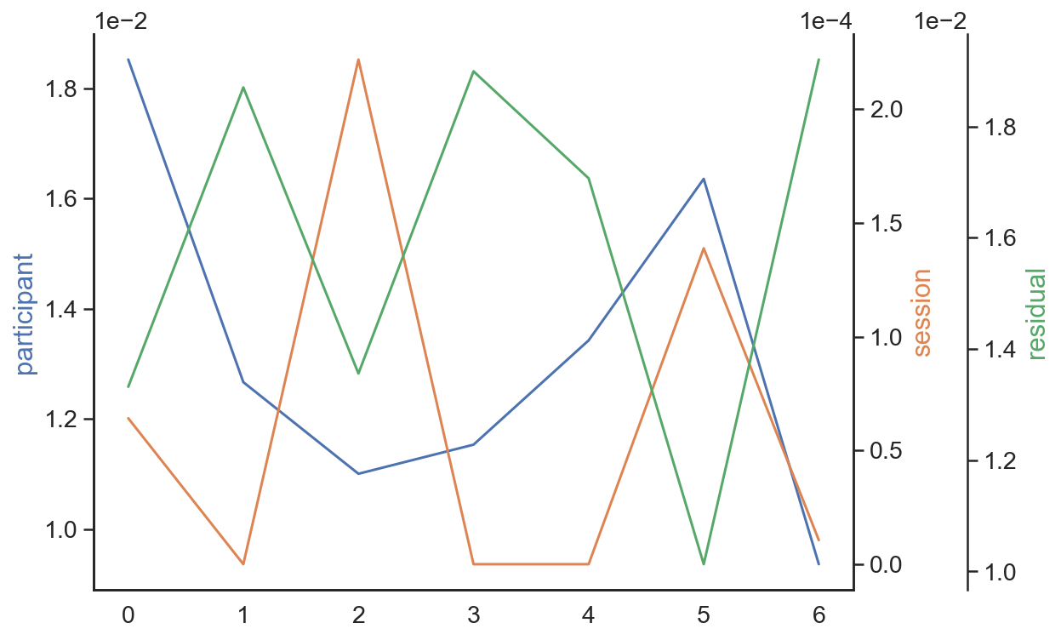
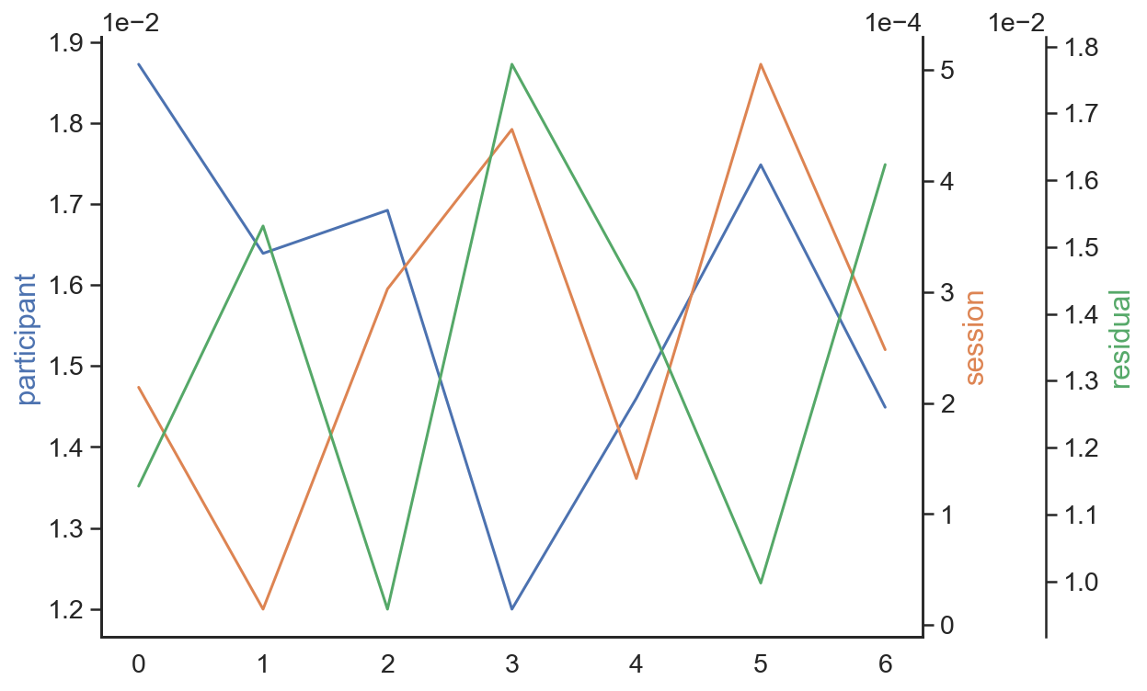
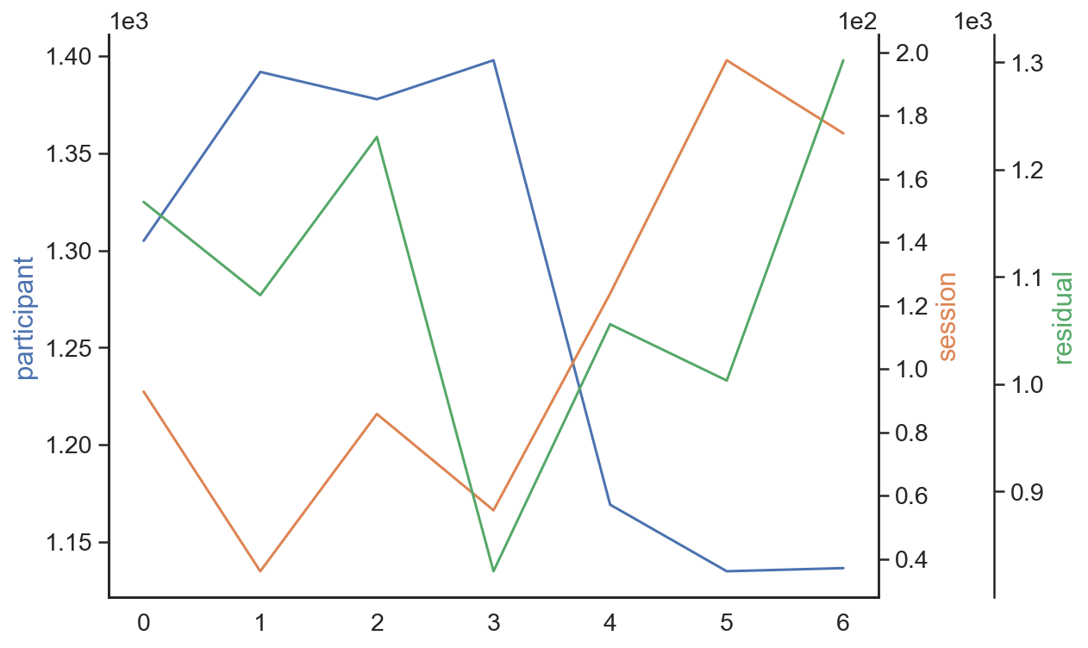
A: Risk Taking
% gambles (win)
% gambles (loss)
% gambles (mixed)
ICC
B: Working memory
C: Information sampling
No distractor (long)
No distractor (short)
ICC
Encoding distractor
Delayed distractor
D: Response inhibition
ICC
Months since first session
Months since first session
Months since first session
Notes:
Absolute variances over time.

Slide 24
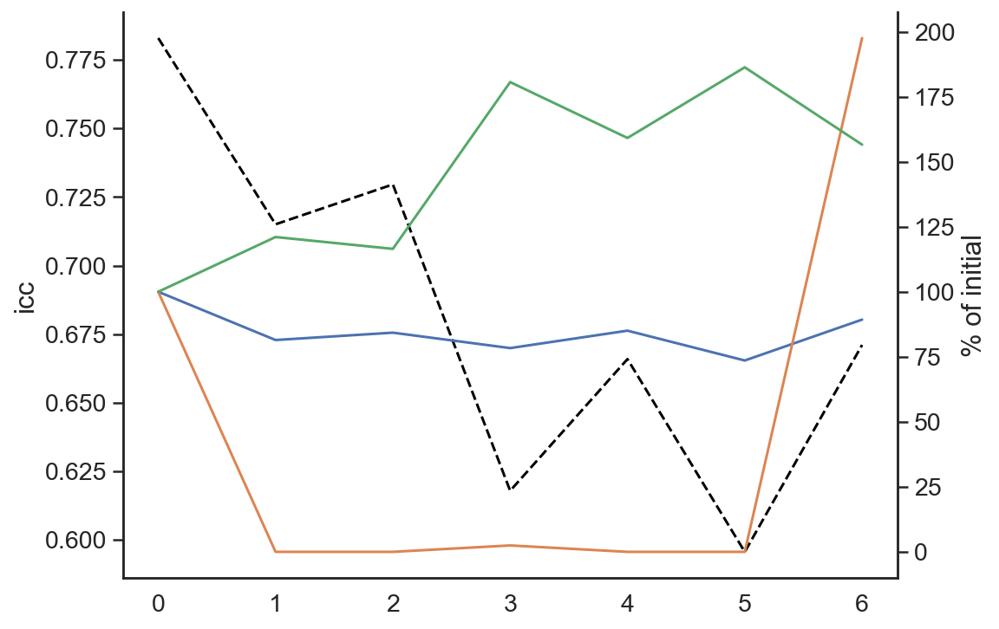
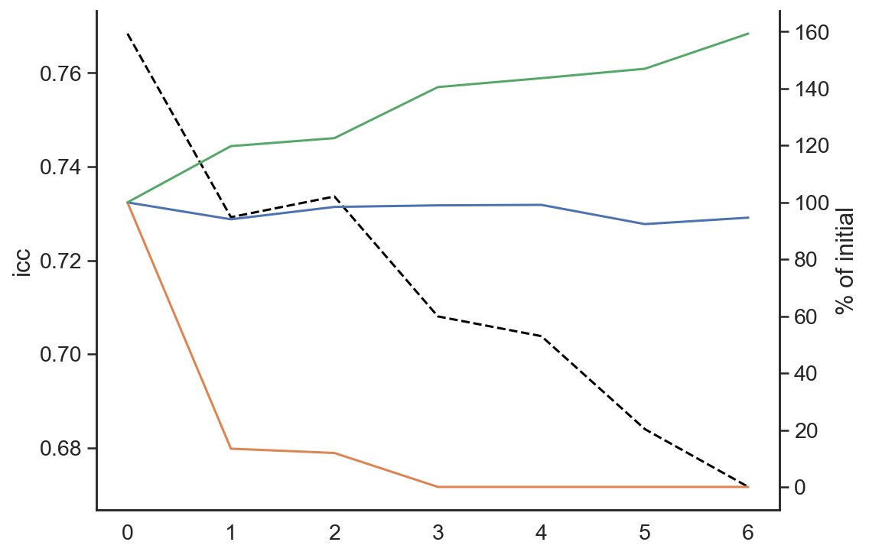
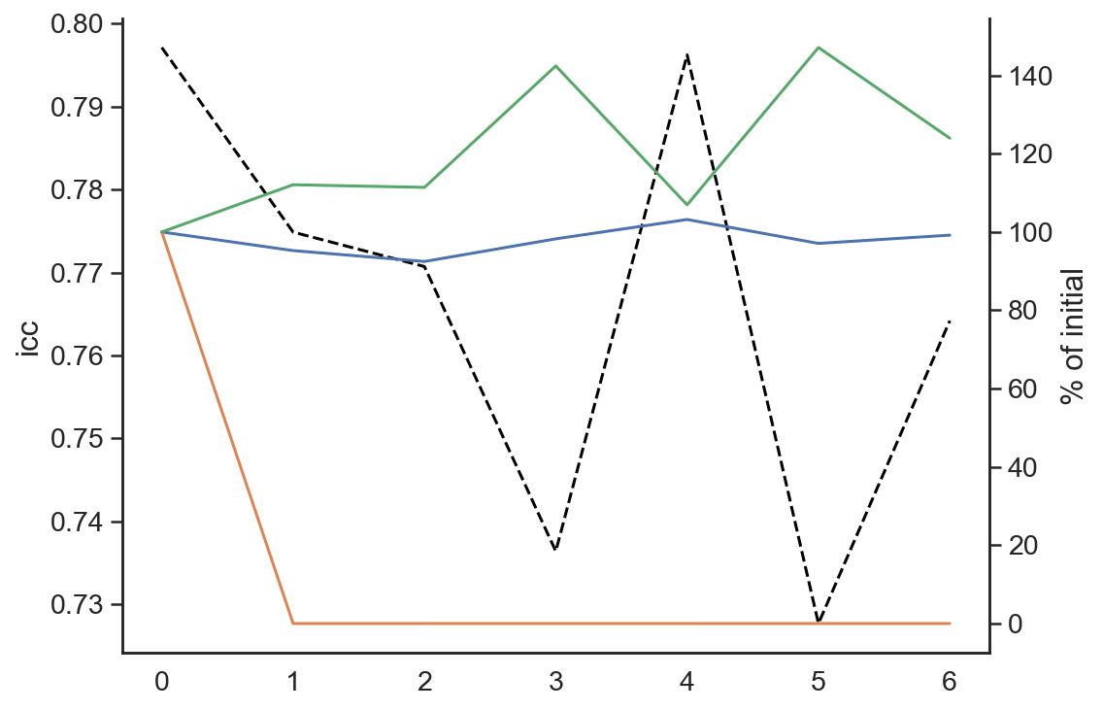
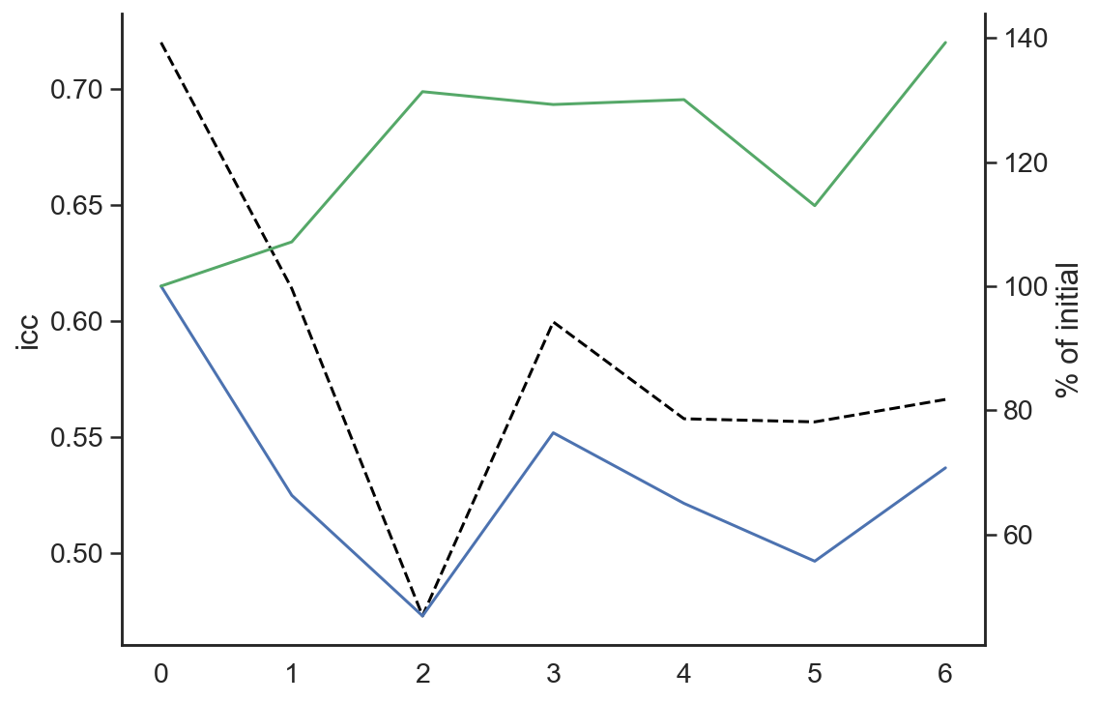
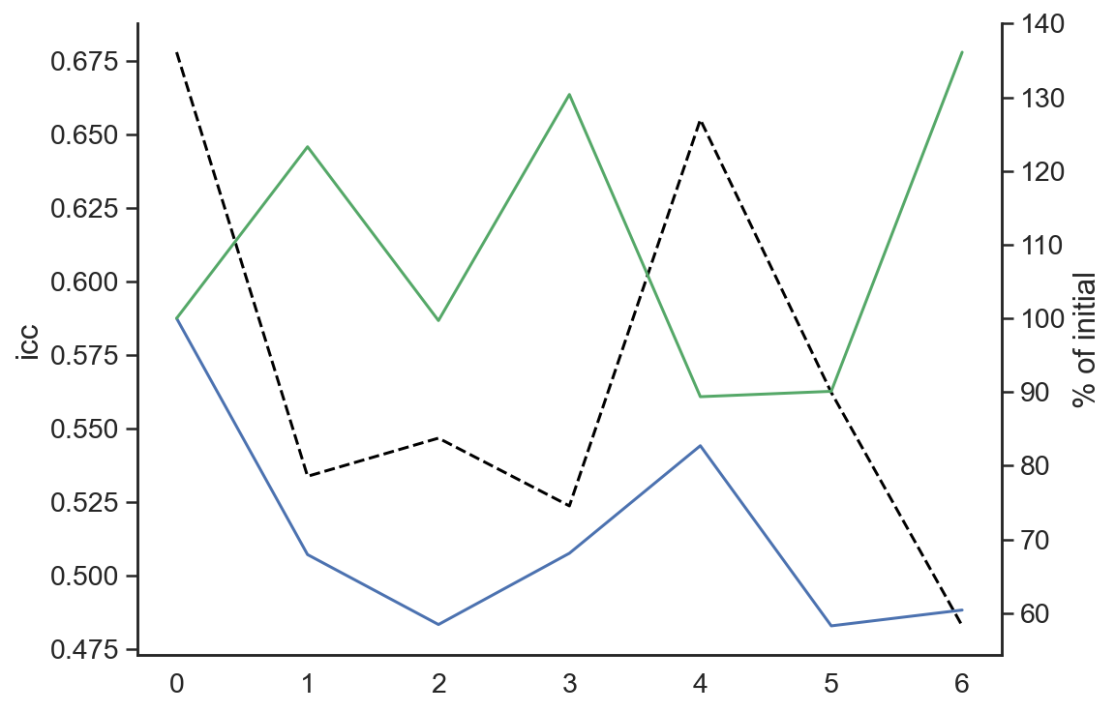
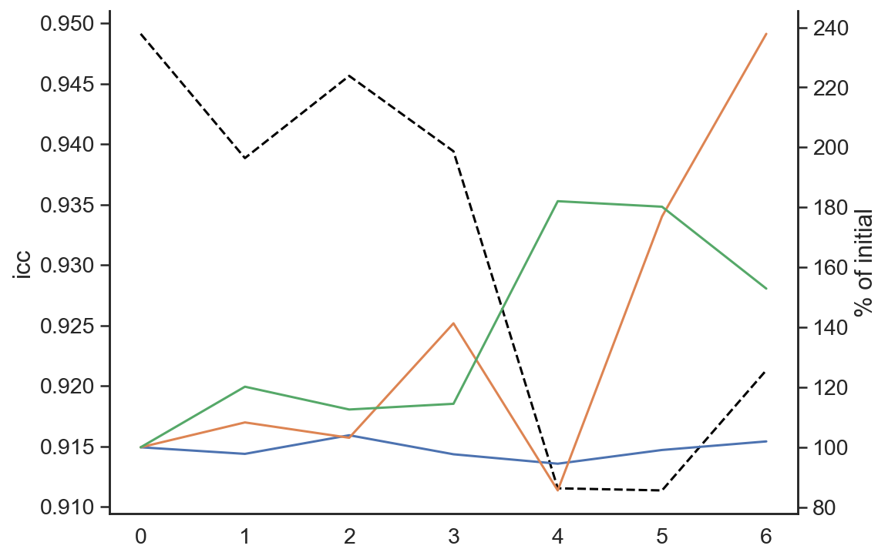
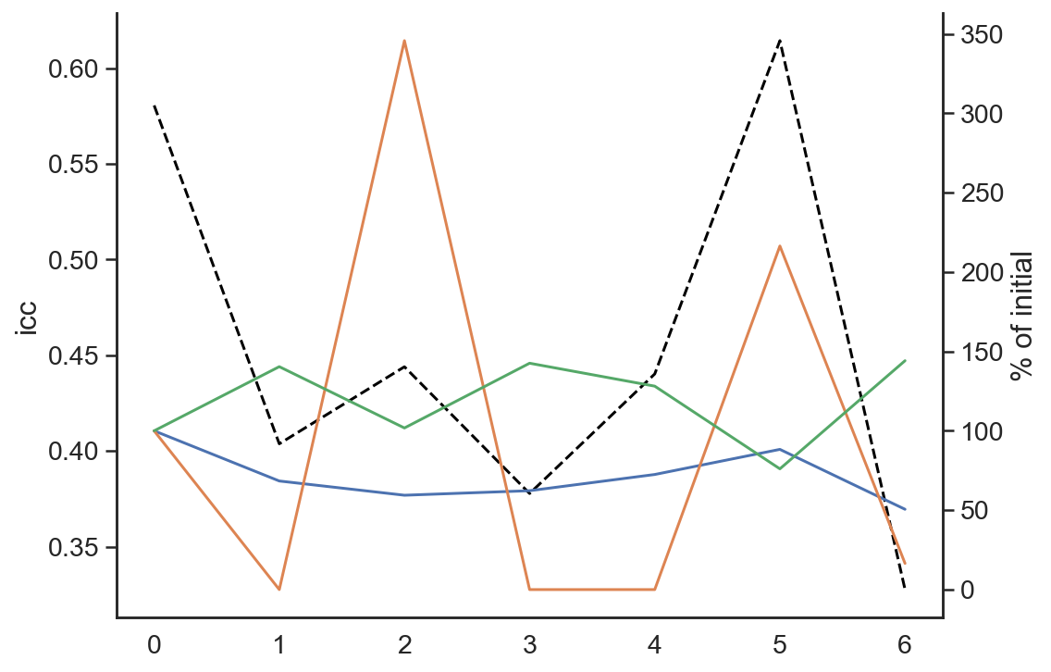
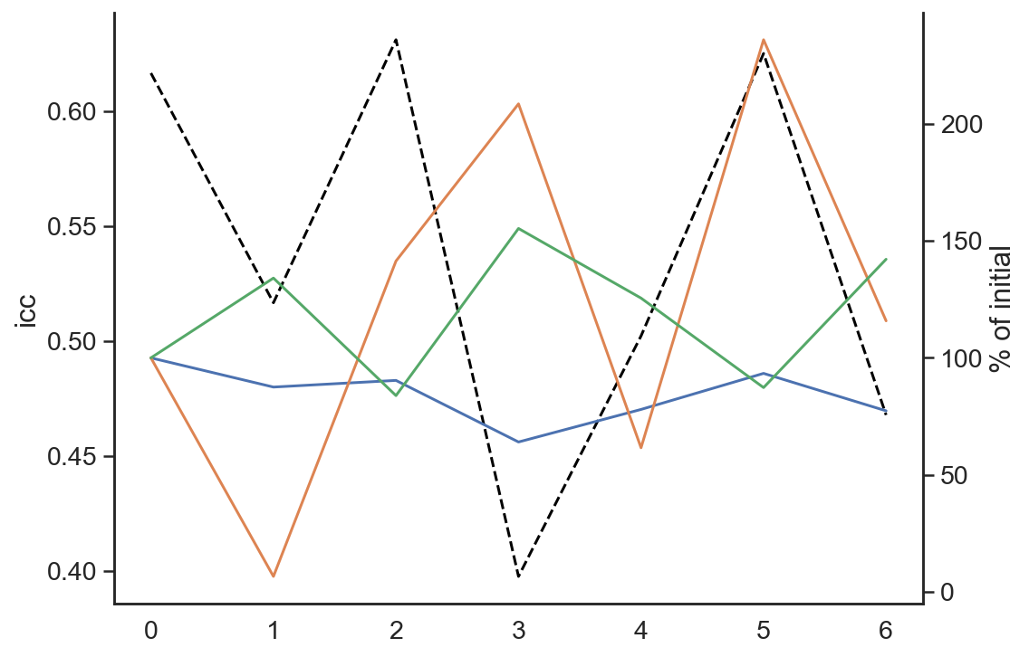
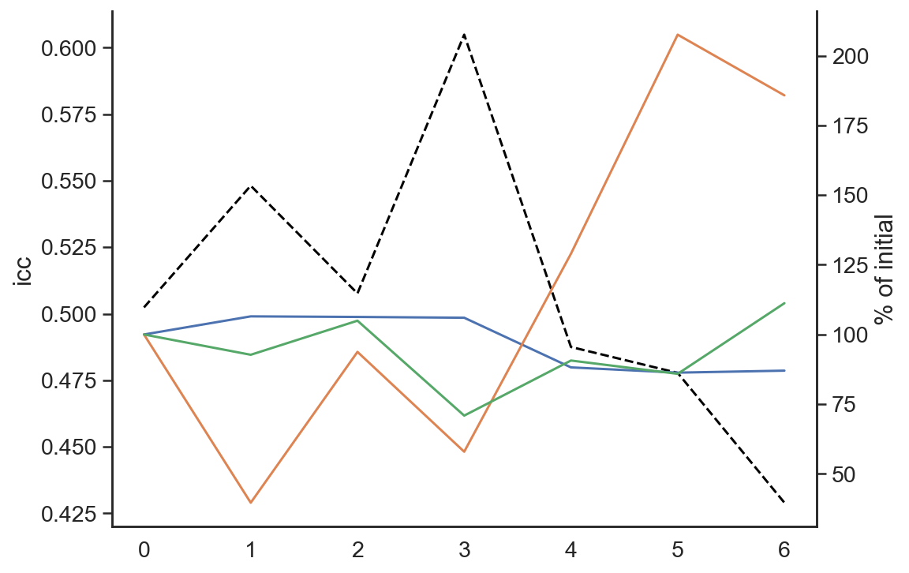
A: Risk Taking
% gambles (win)
% gambles (loss)
% gambles (mixed)
ICC/
Variance change
ICC
ICC
Residual
Session
Participant
B: Working memory
C: Information sampling
No distractor (long)
No distractor (short)
ICC
Encoding distractor
Delayed distractor
D: Response inhibition
ICC
Months since first session
Months since first session
Months since first session
Notes:
Absolute variance change over time.

Slide 25
